Slide 1

Deloitte Lean Six Sigma Method.
Lean Six Sigma Training
Day 1 – Introduction and Mobilisation

Slide 2

Introductions and Welcome About us

Slide 3

Agenda Day 1 - Introduction and Mobilisation
Section 1 | Introductions and Welcome Training Objectives
Section 2 | Background and History of Lean Six Sigma Deloitte Lean Six Sigma – The 5 Workshop Approach
Section 3 | Project Charter Problem Statement Scope (SIPOC)
Section 4 | Design Boundaries Project Governance (including Stakeholder Management)
Section 5 | Introducing the simulation Problem and Allocation of Roles Simulation Round 1
Business Case (Value Tree)
Record and Review Initial Statistics
Data Requirements

Slide 4

Introductions Let’s get to know each other
Introduce yourself:
Name
Favourite food
Area where you work
Previous LSS experience (if any)
Your expectations for the course

Slide 5
Training Structure The Deloitte five workshop approach follows the classic DMAIC Cycle
Define
Measure
Analyse
Improve
Control
M
CS1
CS2
FS1
FS2
W
DAY 1
DAY 2
DAY 3
DAY 4
The whole course is focused around the 5 workshops (from M to FS2):
DMAIC | 5 WS | Stage description | Training
D | M | Mobilisation workshop (2hrs) | Day 1
M | CS1 | Current State 1 workshop (1 day) | Day 2
 | CS2 | Current State 2 workshop (2-3 days)
A | FS1 | Future State 1 workshop (1-2 days) | Day 3
I | FS2 | Future State 2 workshop (1-2 days) | Day 4
I & C | W | Work Pilot (2 to 3 months)
5

Slide 6
Legend for this course Finding your way through the presentation
Navigation
You will be able to track through the presentation using the stage key in the top right hand corner
The presentation is supported by a handbook, which provides details on a number of the tools, techniques and methodologies
Slide Frames
Four different slide frames to distinguish the material content
1. Exercises and Quizzes
3. Examples
Question
Answer
Let’s see
= Examples to illustrate each tool or technics presented
2. Lean Simulation
4. Tutorials “How to”
Try it!
= some practice,
learning by doing!
Workshop agenda
Slide used to facilitate the Lean improvement workshop

Slide 7

Training Objectives What will I learn?
Learning Objectives
By the end of this course, you will know…
Why understanding processes is key to delivering effective change
How to map, measure and analyze processes to identify the key root causes of poor performance and focus on the best ways to improve processes
Tools and techniques that can be used on ANY projects, not just LSS ones
How to implement the principles of Control to sustain the benefits of the improved process
How to use the Lean Workshop approach
How to use Lean Six Sigma principles and tools
When Lean Six Sigma can be used

Slide 8
Agenda Day 1 - Introduction and Mobilisation
Section 1 | Introductions and Welcome Training Objectives
Section 2 | Background and History of Lean Six Sigma Deloitte Lean Six Sigma – The 5 Workshop Approach
Section 3 | Project Charter Problem Statement Scope (SIPOC)
Section 4 | Design Boundaries Project Governance (including Stakeholder Management)
Section 5 | Introducing the simulation Problem and Allocation of Roles Simulation Round 1
Business Case (Value Tree)
Record and Review Initial Statistics
Data Requirements

Slide 9


Quiz What do you already know about Lean Six Sigma?
Split into groups and decide on the following:
3 things you know about LSS?
3 problems you may use LSS to solve?
3 things you would like to know about LSS?
Each team to share findings with the group, when requested by facilitator
Different person to present each point
5 minutes

Slide 10
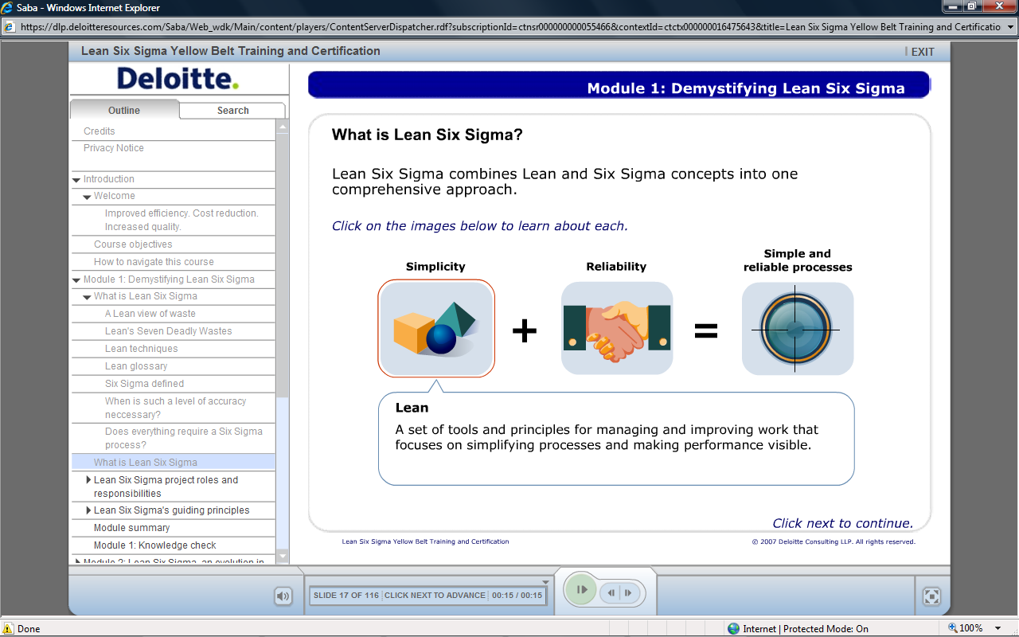
What is Lean Six Sigma?
Lean Six Sigma combines Lean and Six Sigma concepts into one comprehensive approach

Slide 11
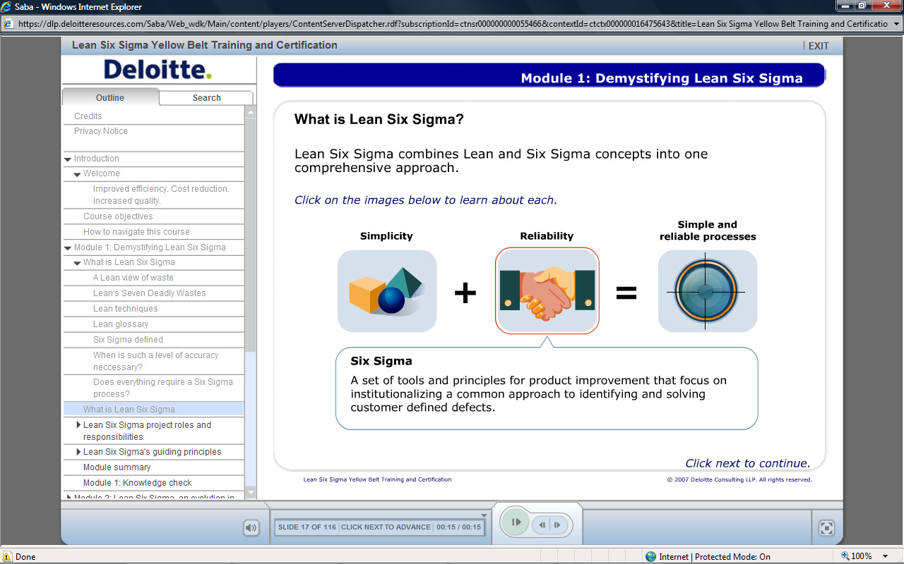
What is Lean Six Sigma?
Lean Six Sigma combines Lean and Six Sigma concepts into one comprehensive approach

Slide 12
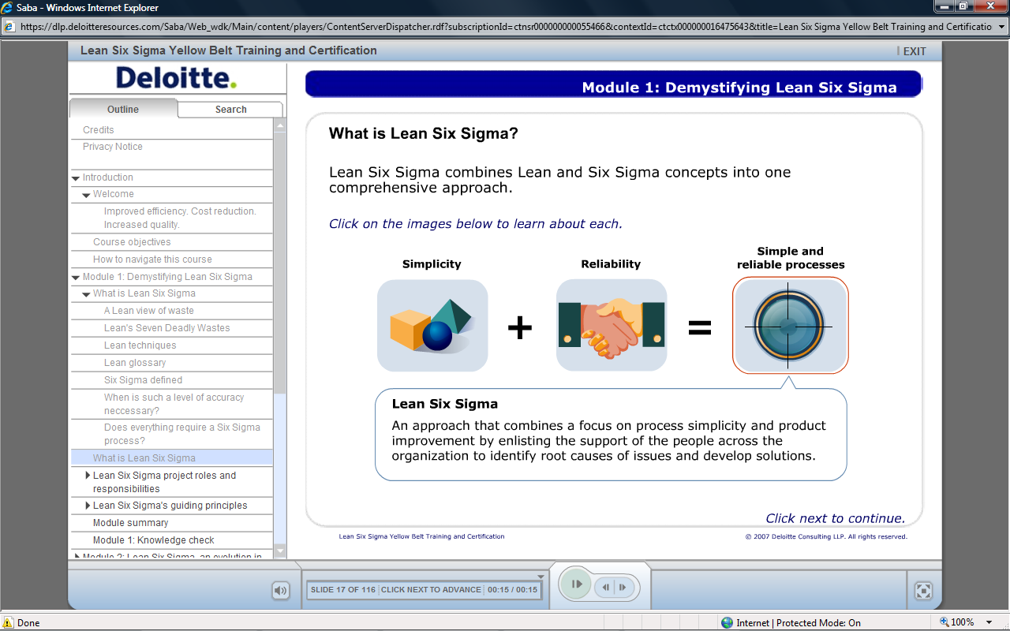
What is Lean Six Sigma?
Lean Six Sigma combines Lean and Six Sigma concepts into one comprehensive approach
Notes:
Process and Product
Process = how to do the work
Product = the forms, files, or reports we are using to do the work

Slide 13
Where did LSS come from? LSS today is the culmination of decades of practice in managing operations
*www.youtube.com/watch?v=6CXso-38ZCA&feature=player_embedded

Slide 14
Lean and Six Sigma We blend the methods and tools according to the problem to solve
Combining the most appropriate technics to focus on the resolution of your business problems

Slide 15
Lean and Six Sigma Using Lean and Six Sigma together
Better customer service
Reduction in unit costs
Increase in capacity
Lead Time
Lean reduces lead time
Six Sigma reduces variation

Slide 16







Fundamentals of LSS Consider the following when gaining an understanding of LSS
A system for improving everyday the performance of a process, product or organisation
Engaging front line in design and regular problem solving iterations
Strategy
Where will the organisation add value?
Thinking in terms of end-to-end processes and systems
Performance from the customers’ perspective
Operations
How will the organisation add value?
What value will the customers recognise?
Value
Fact and Data based decision making
Agile & fast to respond to customers’ new requirements
Treat causes
not symptoms
Focus on making value flow and removing waste and variation
Notes:
Comment on central box:
- 99% of organisations have a Strategy.
- Only 5% have an effective Operational Capability to deliver it

Slide 17
Fundamentals of LSS Building blocks of Lean Six Sigma
Une Culture
Satisfaire les exigences
Des Clients
Respecter
les
équipes
Transformer
le rôle du manager
Le rôle et comportements
du management et des collaborateurs
Des principes
Le Juste
à temps
L’amelio-ration continue
Le Jidoka
Le processus
L’organisation
L’environnement
de travail
Une méthode
Le capital humain
La gouvernance
L’agilité de
l’organisation
Certification
des
compétences
Une approche Top-down
et
Bottom-up
Une boite
à outils

Slide 18
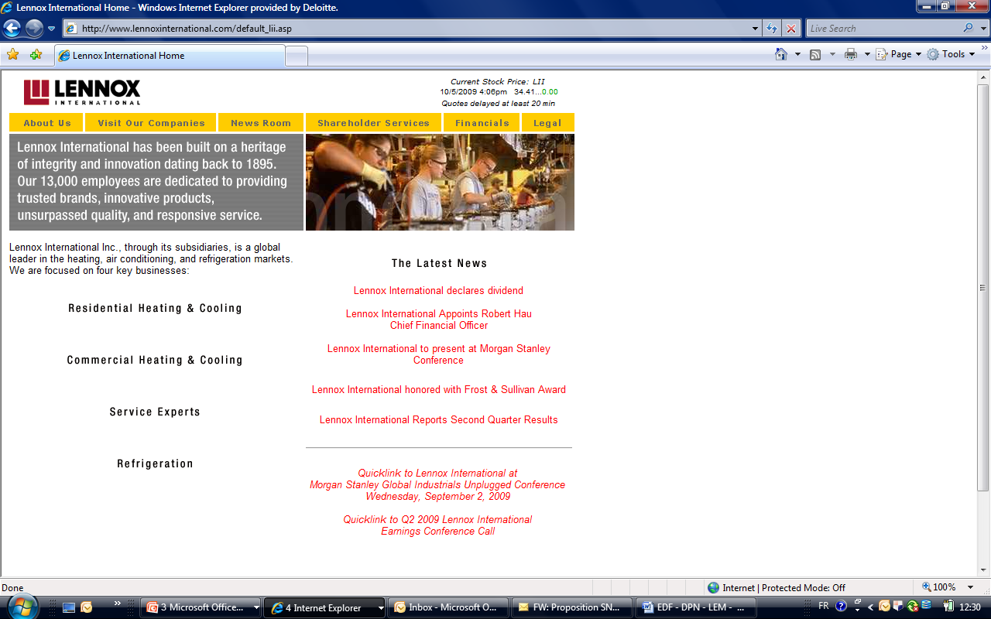








Fundamentals of LSS Helping our clients to resolve their challenges
5. Organisation
1
1
Organisation
Déploiement du Lean management à grande échelle (ex: UK RB)
3
Fonctions métier
Value Streams
Value Streams
2
Amélioration du processus de bout en bout.
Ex : vente d’un prêt
Fonctions métier
3
Amélioration d’une entité métier.
Ex: Agence bancaire; BO
5
Fonctions Support
2
4
Amélioration d’un département support
Ex: RH, Finance
Fonctions Support
4
Problème spécifique
5
Résolution d’un problème endémique et spécifique
Ex: Réconciliation des paiements clients
18

Slide 19
Fundamentals of LSS Lean originated with 5 core principles used to drive continuous improvement
Value
Precisely specify value from the customer’s perspective
Value Stream
Identify the value stream for each product or service
Identify value and the value stream
Sustain and CI
Flow
Create flow without interruptions
Establish Flow & Pull
Pull
Let the customer pull value from the producer
Perfection
Pursue perfection through continuous improvement
Reducing waste
Increasing speed & efficency

Slide 20
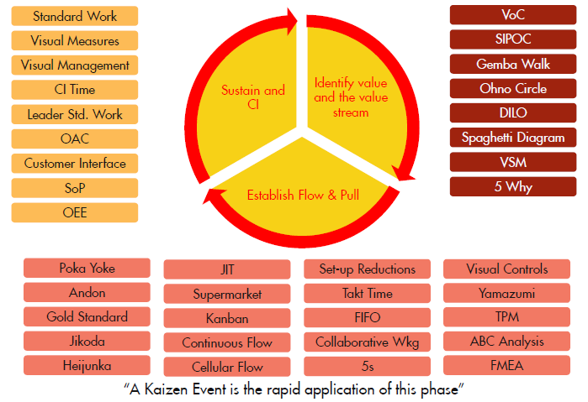
Fundamentals of LSS Applying the 5 principles
Identify value and the value stream
Sustain and CI
Establish Flow & Pull

Slide 21
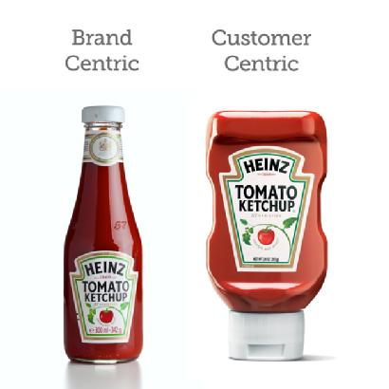
Fundamentals of LSS Focus on the customer – the customer determines process purpose
Why are we here?
Every action has a purpose within a task
Every task has a purpose within a process
Every process has a purpose within a business
But not every action, task or process have a purpose in the eyes of your customer
Value can be defined as any activity essential to delivering the service or product, and can only be determined by your customer
Value Streams align actions, tasks & processes into end to end processes whose purpose is to deliver only your customer and regulatory requirements

Slide 22
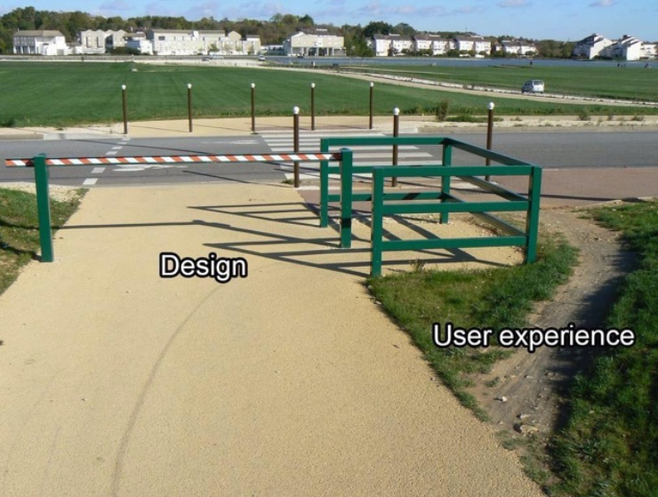
Make Value Flow & Reduce Failure Lean systems focus around flow and “right first time”
Make the value creating activities flow
Line up the essential steps needed to get the job done
Movement should be steady and continuous
Solutions should be developed to remove/minimise the failure demand and wastes
Physically rearrange to support continuous flow and best serve the customer
Make only what the customer needs
Think end to end
Departments and functions should be rethought in the context of a specific single service provision

Slide 23

Value & Failure demand Lean identifies two types of demand placed upon an organisation
Resources in an organisation all have demands on their time when conducting their day to day activities:
Value demand: the demand placed on an organisation as a result of a request that adds additional value to the business e.g. new customers, cross-selling, policy renewal
Failure demand: can be defined as the demand placed on an organisation as a result of their failures e.g. time lost to order status enquiries, time lost to resolve a complaint, time lost to request missing information
The bottom line: Failure demand increases resources & costs, while adding no value

Slide 24
Result of LSS process improvement
The Lean goal is to achieve more customer value using less resource by eliminating waste and reducing end-to-end time
Before Lean project
A service value stream: e.g. processing an application
Customer wants widget as fast as possible, with no mistakes and great customer service
day 1
lead time (LT)
day 30
After Lean project
Value demand better handled,
Failure demand removed
day 1
lead time (LT)
day 8
Where the gains come from
Small
Adds value to the customer
Small to medium
No value; needs to be done
Large
No value; no need to be done
The bottom line: better customer service costs less not more!
Video: Visa and Lean - www.youtube.com/watch?v=U86bTrsdShg
Notes:
Lean is all about flowing more value to the customers for less resource. After Lean Project view shows greater proportion of process is VA to customer activities.
Explain process takes for instance 30 days
When you look at what the application is doing you will find:
Waste examples: Waiting time, transport, rework

Slide 25




Result of LSS process improvement A Lean Six Sigma project impacts four performance dimensions
On time and speed of service
Quality
Efficiency
Risk
Increasing quality to deliver better customer service with zero error
For specific products and services, guaranteed lead-time to delivery is a key element of the value proposition
Pressure on margins and costs require continuous productivity improvements
Stronger focus on the management of risk and transparency of controls
“Provide the most value from the customers perspective, while consuming the fewest resources and utilising the talents of the people who do the work”
Dan Jones, “Lean Thinking”
Notes:
Result is making life easier for people

Slide 26



Result of LSS process improvement Improving bot clients satisfaction and employees engagement
Collaborateurs
Montée en compétences
Activités à plus haute valeur ajoutée
Amélioration du bien-être au travail
Bénéfique pour les employés
Bénéfique pour l’organisation
Bénéfique pour le client
Organisation
Vision collaborative de bout en bout, et plus en silos
Efficience renforcée par des processus revus et des idées innovantes, venant du terrain
Client
Amélioration du service rendu
Optimisation de la relation client
Notes:
Result is making life easier for people

Slide 27
A structured approach to problem solving
Define
Define Goal, Scope and Success Criteria
Measure
Measure Critical-to- Customer Quality Factors
Analyze
Conduct Root- Cause Analysis
Improve Design and Pilot Improved Processes
Control
Fine-Tune Processes & Metrics
Project management
Scope and plan the project
Understand the stakeholders (Voice of Customer - VOC)
Prioritize and select key areas to measure (data collection plan)
Engage stakeholders and develop change strategy
Measure key areas and defects
Gather detailed VOC
Determine critical to quality and process requirements
Perform As-Is Value Stream Mapping and Non-Value Added Analysis
Identify opportunity areas
Lean Six Sigma coaching
Implement future state
Identify areas for continuous improvement
Monitor benefits
Complete capability transfer
Root cause analysis
Develop and validate hypotheses
Define financial impact and develop business case
Develop conceptual designs of future state solutions / map
Develop and prioritize solutions
Design detailed future state plan
Conduct pilots
Implement quick hits
Deploy change management programs
Change and performance management
M
Mobilise
CS1
Current State 1
CS2
Current State 2
FS1
Future State 1
FS2
Future S 2
Work Pilot
Test and deploy future state
Plan and mobilise the project
VOC ➔ CTQ
Plan As-Is
Map the As-Is and measure
Analyse and develop To-Be
Plan solutions
Test through a pilot and implement the prioritised solutions

Slide 28
An approach cadenced by engaging workshops
1. Mobilization
2. Current State
3. Future State
4. Implementation plan and test
Week 1
M | T | W | T | F
Week 2
M | T | W | T | F
Week 3
M | T | W | T | F
Week 4
M | T | W | T | F
Week 5
M | T | W | T | F
Week 6 to 16
M | T | W | T | F
½ j
1 d
2 to 3 d
1 to 2 d
1 to 2 d
2 to 3 months
M
Mobilisation:
Confirm the scope, mobilise the team and Kick-off the project
½ day
CS1
The project is defined with a clear understanding of the customers and business expectations
Current State 1:
1 day
CS2
Current State 2:
The team members “walk the process” to map and analyse the current state and to identify the waste and opportunities
3 days
FS1
The team is encouraged to undertake blue-sky thinking, learn about Lean solutions, and develop the improved future state
Future State 1:
2 days
FS2
The team draft the implementation plan of the prioritized actions, starting with a work pilot to test and refine the solution
Future State 2:
2 days
WP
The team tests the changes and experiment with new ways of working before roll-out to the other teams
Work Pilot:
8 weeks

Slide 29
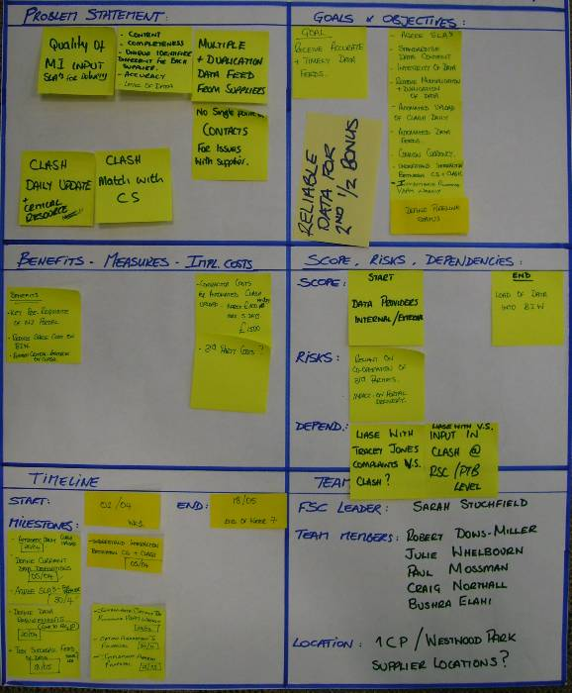
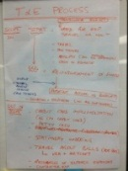
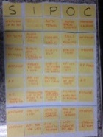
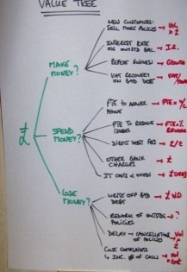
Zooming through the 5 workshop approach
1. Mobilization
2. Current State
3. Future State
4. Implementation plan and test
Week 1
M | T | W | T | F
Week 2
M | T | W | T | F
Week 3
M | T | W | T | F
Week 4
M | T | W | T | F
Week 5
M | T | W | T | F
Week 6 to 16
M | T | W | T | F
½ j
1 d
2 to 3 d
1 to 2 d
1 to 2 d
2 to 3 months
Mobilization
Validate the project charter
ILLUSTRATION
Objectives
Validate the scope and objectives
Select the project team
Agree the project plan
Scope
Charter
Key activities
Lean Awareness
Validation of end to end process scope
Value tree analysis
Refine charter
Initial identification of data requirements
Identify design boundaries
SIPOC
Value tree
Tools
Problem scoping
Identify process owners, suppliers, customers (SIPOC)
Value Tree
Data collection
Project Charter
Notes:
Waste for service environment:
Transport – Any unnecessary movement of material, products, documents or information can be described as waste. This reflects on activities moving from one individual to another, within departments or between departments, which adds time to the overall process. In
the service environment, this manifests itself as tasks to be collected and delivered, physically or virtually.
Inventory - It’s the physical piles of un-cleared inboxes, list of pending enquiries or emails or time a client spends in a queue.
Motion - It is the unnecessary movement of people or resources. The physical movement of personnel from a station to another to continue a process is an example of motion. Others include the switching between computer terminals or databases, is a form of motion, which requires additional steps to be executed before a truly value-adding step can be carried out.
Waiting - It is the elapsed time between the end of a process step or activity to the beginning of another. Waiting may have a direct or indirect impact to the customer. The time spent waiting between processes results in customers having to wait for the delivery the service.
Over processing - Generically, Over-Processing means adding more work to the service than necessary, trying to exceed the customers’ requirement. This in-fact translates to adding more value to a service than what a customer is willing to pay for. These are typically caused by not clearly understanding the customer’s requirement or having to manage redundancy in process.
Over production - Over-Production is the use of capacity and capability beyond the mean of the present service or product requirement, resulting in outputs that are not delivered to customers. Over-production, in a sense, is work carried out ahead of customers’ need and
can also result is wastes as the services are performed without the clear understanding the customer’s requirement or when there is no demand from the customer.
Defects - The waste of defect is always seen when nonconformity exists. When products or services do not conform to a customer’s demand, then it’s a defect, and all effort in time, resources, materials and cost are wasted. There is a price to pay for non-conformity.
For an organization, it has produced work or service that a customer in not willing to pay for – and ultimately driving the customer to see an alternate provider for the products and services. Typically, the voice of customer is heard when a defect occurs, in the form of complaints. And many organizations engage in improving the complaints handling processes and fail to focus on the process value stream to identify where the defect occurs. Eliminating the root cause of defects presents a lasting solution to eliminating this waste.

Slide 30
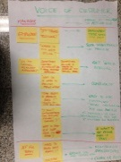
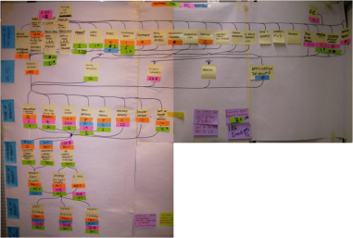
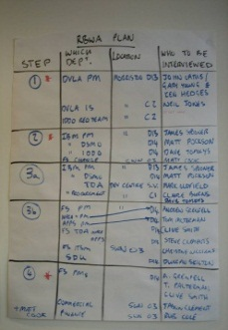
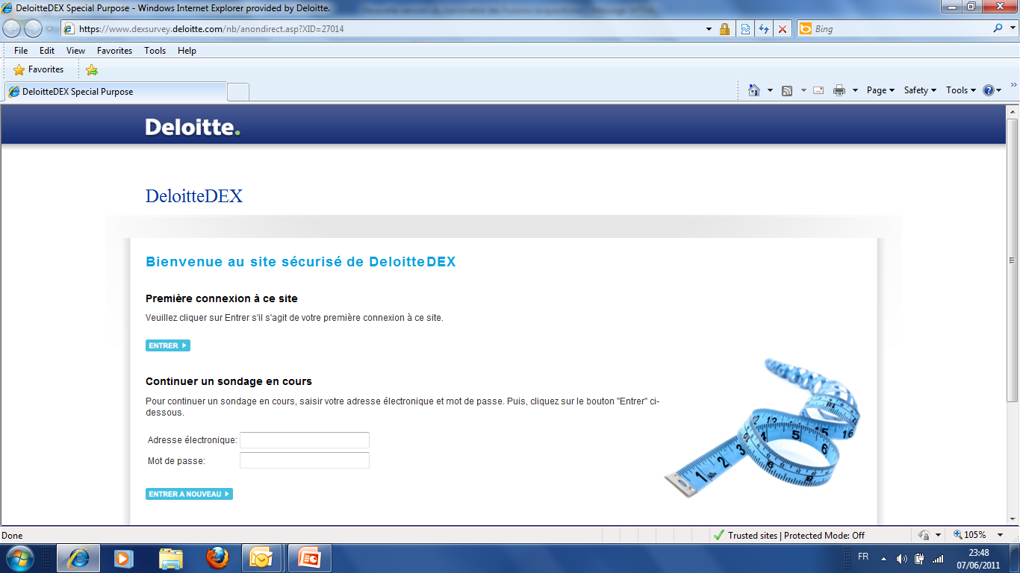
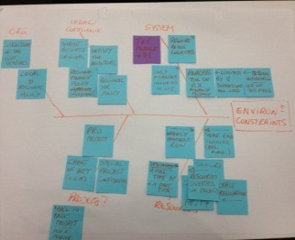
Zooming through the 5 workshop approach
1. Mobilization
2. Current State
3. Future State
4. Implementation plan and test
Week 1
M | T | W | T | F
Week 2
M | T | W | T | F
Week 3
M | T | W | T | F
Week 4
M | T | W | T | F
Week 5
M | T | W | T | F
Week 6 to 16
M | T | W | T | F
½ j
1 d
2 to 3 d
1 to 2 d
1 to 2 d
2 to 3 months
CS 1 Workshop
Macro analysis of the current state
ILLUSTRATION
Objectives
Define what is Critical to Quality and customer expectations (CTQ)
Plan the interviews and the observation of the real process
VoC and VoB
Customer demand analysis
Key activities
Review charter, SIPOC and Customer demand
Understand who the customers are (VOC) and their key requirements (CTQ)
Establish the Value Stream Flow
Recognize a “Just do it” activity
Plan for ‘seeing is believing’
Preparation for “Seeing is believing”
Online surveys or customer data
Design boundaries to clarify & validate
Tools
VOC data & CTQ
Understand demand - Mississippi Chart
Runners, Repeaters and Strangers
Value tree
Introduction to Waste analysis
Notes:
Waste for service environment:
Transport – Any unnecessary movement of material, products, documents or information can be described as waste. This reflects on activities moving from one individual to another, within departments or between departments, which adds time to the overall process. In
the service environment, this manifests itself as tasks to be collected and delivered, physically or virtually.
Inventory - It’s the physical piles of un-cleared inboxes, list of pending enquiries or emails or time a client spends in a queue.
Motion - It is the unnecessary movement of people or resources. The physical movement of personnel from a station to another to continue a process is an example of motion. Others include the switching between computer terminals or databases, is a form of motion, which requires additional steps to be executed before a truly value-adding step can be carried out.
Waiting - It is the elapsed time between the end of a process step or activity to the beginning of another. Waiting may have a direct or indirect impact to the customer. The time spent waiting between processes results in customers having to wait for the delivery the service.
Over processing - Generically, Over-Processing means adding more work to the service than necessary, trying to exceed the customers’ requirement. This in-fact translates to adding more value to a service than what a customer is willing to pay for. These are typically caused by not clearly understanding the customer’s requirement or having to manage redundancy in process.
Over production - Over-Production is the use of capacity and capability beyond the mean of the present service or product requirement, resulting in outputs that are not delivered to customers. Over-production, in a sense, is work carried out ahead of customers’ need and
can also result is wastes as the services are performed without the clear understanding the customer’s requirement or when there is no demand from the customer.
Defects - The waste of defect is always seen when nonconformity exists. When products or services do not conform to a customer’s demand, then it’s a defect, and all effort in time, resources, materials and cost are wasted. There is a price to pay for non-conformity.
For an organization, it has produced work or service that a customer in not willing to pay for – and ultimately driving the customer to see an alternate provider for the products and services. Typically, the voice of customer is heard when a defect occurs, in the form of complaints. And many organizations engage in improving the complaints handling processes and fail to focus on the process value stream to identify where the defect occurs. Eliminating the root cause of defects presents a lasting solution to eliminating this waste.

Slide 31
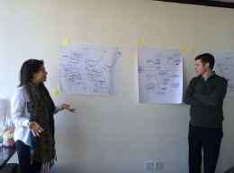
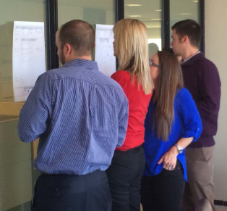
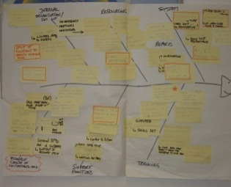
Zooming through the 5 workshop approach
1. Mobilization
2. Current State
3. Future State
4. Implementation plan and test
Week 1
M | T | W | T | F
Week 2
M | T | W | T | F
Week 3
M | T | W | T | F
Week 4
M | T | W | T | F
Week 5
M | T | W | T | F
Week 6 to 16
M | T | W | T | F
½ j
1 d
2 to 3 d
1 to 2 d
1 to 2 d
2 to 3 months
CS2 Workshop
Detailed current state mapping & analysis
End to end process mapping and analysis of the waste and inefficiencies, highlighting improvement opportunities
ILLUSTRATION
Objectives
Mapping of the current state
Presentation of findings to sponsor and key stakeholders
Key activities
Seeing is Believing - Walk the process to understand what really happens and what the key issues are
Construct the current end to end value stream map
Start identifying all issues / non-value add / wastes on the value stream map
Report back to sponsors and stakeholders
Tools
Seeing is Believing
Value stream mapping
Baseline Metrics
7 wastes analysis
Spaghetti diagram
End to end Value Stream Map
Causes & effects analysis
Notes:
Waste for service environment:
Transport – Any unnecessary movement of material, products, documents or information can be described as waste. This reflects on activities moving from one individual to another, within departments or between departments, which adds time to the overall process. In
the service environment, this manifests itself as tasks to be collected and delivered, physically or virtually.
Inventory - It’s the physical piles of un-cleared inboxes, list of pending enquiries or emails or time a client spends in a queue.
Motion - It is the unnecessary movement of people or resources. The physical movement of personnel from a station to another to continue a process is an example of motion. Others include the switching between computer terminals or databases, is a form of motion, which requires additional steps to be executed before a truly value-adding step can be carried out.
Waiting - It is the elapsed time between the end of a process step or activity to the beginning of another. Waiting may have a direct or indirect impact to the customer. The time spent waiting between processes results in customers having to wait for the delivery the service.
Over processing - Generically, Over-Processing means adding more work to the service than necessary, trying to exceed the customers’ requirement. This in-fact translates to adding more value to a service than what a customer is willing to pay for. These are typically caused by not clearly understanding the customer’s requirement or having to manage redundancy in process.
Over production - Over-Production is the use of capacity and capability beyond the mean of the present service or product requirement, resulting in outputs that are not delivered to customers. Over-production, in a sense, is work carried out ahead of customers’ need and
can also result is wastes as the services are performed without the clear understanding the customer’s requirement or when there is no demand from the customer.
Defects - The waste of defect is always seen when nonconformity exists. When products or services do not conform to a customer’s demand, then it’s a defect, and all effort in time, resources, materials and cost are wasted. There is a price to pay for non-conformity.
For an organization, it has produced work or service that a customer in not willing to pay for – and ultimately driving the customer to see an alternate provider for the products and services. Typically, the voice of customer is heard when a defect occurs, in the form of complaints. And many organizations engage in improving the complaints handling processes and fail to focus on the process value stream to identify where the defect occurs. Eliminating the root cause of defects presents a lasting solution to eliminating this waste.

Slide 32
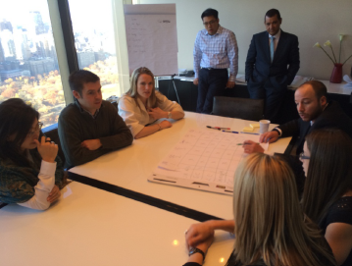
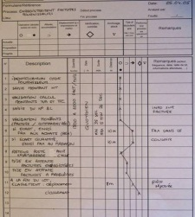
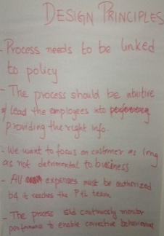
Zooming through the 5 workshop approach
1. Mobilization
2. Current State
3. Future State
4. Implementation plan and test
Week 1
M | T | W | T | F
Week 2
M | T | W | T | F
Week 3
M | T | W | T | F
Week 4
M | T | W | T | F
Week 5
M | T | W | T | F
Week 6 to 16
M | T | W | T | F
½ j
1 d
2 to 3 d
1 to 2 d
1 to 2 d
2 to 3 months
FS1 Workshop
Definition of the future state
Establish the future state based on key Lean principles and the blue sky vision
ILLUSTRATION
Objectives
Design of the future state
Presentation of findings to sponsor and key stakeholders
Value add analysis
Design principles
Key activities
Review waste analysis; identify what is preventing the value to flow
Define blue sky vision and agree future state lean design principles
Map the future state
Highlight benefits
Report out sessions to present future state proposal
Tools
Lean design principles
Takt time / Cycle time diagram / Load balancing
Pull systems, one piece flow & JIT
Mistake proofing
Andon system
Future State Value Stream
Notes:
Waste for service environment:
Transport – Any unnecessary movement of material, products, documents or information can be described as waste. This reflects on activities moving from one individual to another, within departments or between departments, which adds time to the overall process. In
the service environment, this manifests itself as tasks to be collected and delivered, physically or virtually.
Inventory - It’s the physical piles of un-cleared inboxes, list of pending enquiries or emails or time a client spends in a queue.
Motion - It is the unnecessary movement of people or resources. The physical movement of personnel from a station to another to continue a process is an example of motion. Others include the switching between computer terminals or databases, is a form of motion, which requires additional steps to be executed before a truly value-adding step can be carried out.
Waiting - It is the elapsed time between the end of a process step or activity to the beginning of another. Waiting may have a direct or indirect impact to the customer. The time spent waiting between processes results in customers having to wait for the delivery the service.
Over processing - Generically, Over-Processing means adding more work to the service than necessary, trying to exceed the customers’ requirement. This in-fact translates to adding more value to a service than what a customer is willing to pay for. These are typically caused by not clearly understanding the customer’s requirement or having to manage redundancy in process.
Over production - Over-Production is the use of capacity and capability beyond the mean of the present service or product requirement, resulting in outputs that are not delivered to customers. Over-production, in a sense, is work carried out ahead of customers’ need and
can also result is wastes as the services are performed without the clear understanding the customer’s requirement or when there is no demand from the customer.
Defects - The waste of defect is always seen when nonconformity exists. When products or services do not conform to a customer’s demand, then it’s a defect, and all effort in time, resources, materials and cost are wasted. There is a price to pay for non-conformity.
For an organization, it has produced work or service that a customer in not willing to pay for – and ultimately driving the customer to see an alternate provider for the products and services. Typically, the voice of customer is heard when a defect occurs, in the form of complaints. And many organizations engage in improving the complaints handling processes and fail to focus on the process value stream to identify where the defect occurs. Eliminating the root cause of defects presents a lasting solution to eliminating this waste.

Slide 33
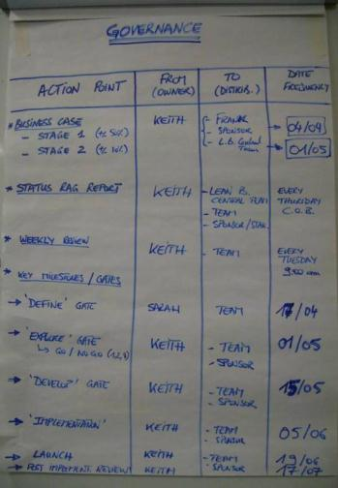
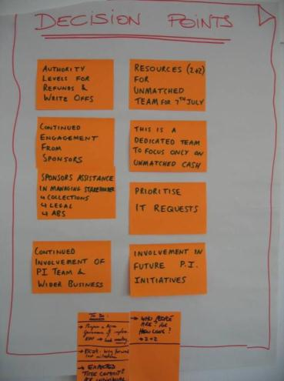
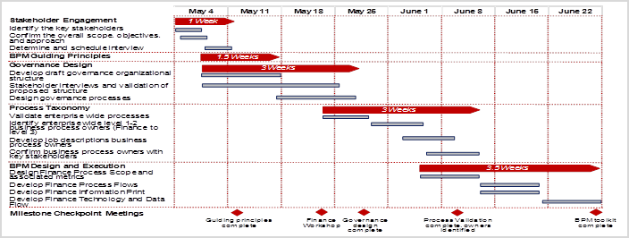
Zooming through the 5 workshop approach
1. Mobilization
2. Current State
3. Future State
4. Implementation plan and test
Week 1
M | T | W | T | F
Week 2
M | T | W | T | F
Week 3
M | T | W | T | F
Week 4
M | T | W | T | F
Week 5
M | T | W | T | F
Week 6 to 16
M | T | W | T | F
½ j
1 d
2 to 3 d
1 to 2 d
1 to 2 d
2 to 3 months
FS2 Workshop
Prepare the implementation of the solutions
Anticipate the work pilot and establish the plan to deliver and test the solutions to implement the future state
ILLUSTRATION
Objectives
Establish implementation plan and the charter for the mini projects to drive
Final presentation of the diagnostic phase to the sponsor & stakeholders
Priority matrix
Implementation plan
Key activities
Identify all changes required to achieve the future state
Prioritize the actions
Establish the implementation plan
Validate the work pilot scope and objectives
Agree the governance and how to involve all key parties
Governance
Key decisions
Tools
Project charters
Prioritization matrix
Gantt chart
Project management
Notes:
Waste for service environment:
Transport – Any unnecessary movement of material, products, documents or information can be described as waste. This reflects on activities moving from one individual to another, within departments or between departments, which adds time to the overall process. In
the service environment, this manifests itself as tasks to be collected and delivered, physically or virtually.
Inventory - It’s the physical piles of un-cleared inboxes, list of pending enquiries or emails or time a client spends in a queue.
Motion - It is the unnecessary movement of people or resources. The physical movement of personnel from a station to another to continue a process is an example of motion. Others include the switching between computer terminals or databases, is a form of motion, which requires additional steps to be executed before a truly value-adding step can be carried out.
Waiting - It is the elapsed time between the end of a process step or activity to the beginning of another. Waiting may have a direct or indirect impact to the customer. The time spent waiting between processes results in customers having to wait for the delivery the service.
Over processing - Generically, Over-Processing means adding more work to the service than necessary, trying to exceed the customers’ requirement. This in-fact translates to adding more value to a service than what a customer is willing to pay for. These are typically caused by not clearly understanding the customer’s requirement or having to manage redundancy in process.
Over production - Over-Production is the use of capacity and capability beyond the mean of the present service or product requirement, resulting in outputs that are not delivered to customers. Over-production, in a sense, is work carried out ahead of customers’ need and
can also result is wastes as the services are performed without the clear understanding the customer’s requirement or when there is no demand from the customer.
Defects - The waste of defect is always seen when nonconformity exists. When products or services do not conform to a customer’s demand, then it’s a defect, and all effort in time, resources, materials and cost are wasted. There is a price to pay for non-conformity.
For an organization, it has produced work or service that a customer in not willing to pay for – and ultimately driving the customer to see an alternate provider for the products and services. Typically, the voice of customer is heard when a defect occurs, in the form of complaints. And many organizations engage in improving the complaints handling processes and fail to focus on the process value stream to identify where the defect occurs. Eliminating the root cause of defects presents a lasting solution to eliminating this waste.

Slide 34
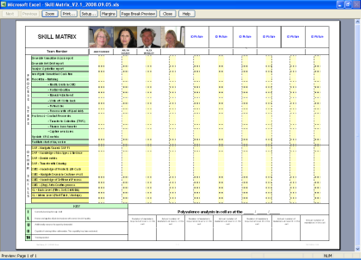
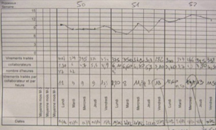
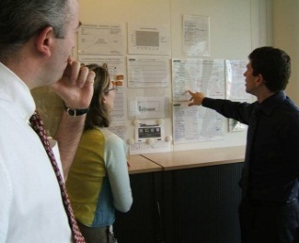
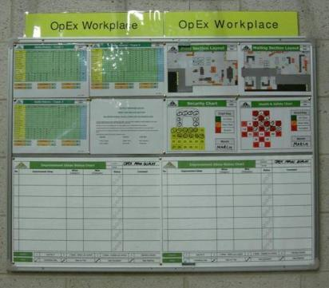
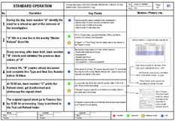
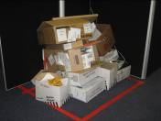
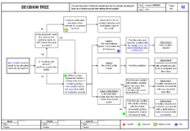
Zooming through the 5 workshop approach
1. Mobilization
2. Current State
3. Future State
4. Implementation plan and test
Week 1
M | T | W | T | F
Week 2
M | T | W | T | F
Week 3
M | T | W | T | F
Week 4
M | T | W | T | F
Week 5
M | T | W | T | F
Week 6 to 16
M | T | W | T | F
½ j
1 d
2 to 3 d
1 to 2 d
1 to 2 d
2 to 3 months
Work pilot
Implementation of solutions and new ways of working
Kick off continuous improvement momentum through the implementation of the work pilot (establish the new standards, measure improved performance, identify new issues and drive problem solving activities)
ILLUSTRATION
Objectives
Implement new ways of working and test the future state solutions
Confirm the expected benefits and roll out the solutions
Key activities
Develop standard operating procedures
Tests & adjust the new processes and ways of working
Set up and measure new KPIs
Use visual management to identify new issues, track progress and facilitate problem solving activities
Competency matrix
Manual dashboard
Daily stand up
SOP
Visual management
5S workshops
Tools
Standardization, 5S
Competency matrix
Visual management
FMEA
Daily performance reviews
Problem solving
Notes:
Waste for service environment:
Transport – Any unnecessary movement of material, products, documents or information can be described as waste. This reflects on activities moving from one individual to another, within departments or between departments, which adds time to the overall process. In
the service environment, this manifests itself as tasks to be collected and delivered, physically or virtually.
Inventory - It’s the physical piles of un-cleared inboxes, list of pending enquiries or emails or time a client spends in a queue.
Motion - It is the unnecessary movement of people or resources. The physical movement of personnel from a station to another to continue a process is an example of motion. Others include the switching between computer terminals or databases, is a form of motion, which requires additional steps to be executed before a truly value-adding step can be carried out.
Waiting - It is the elapsed time between the end of a process step or activity to the beginning of another. Waiting may have a direct or indirect impact to the customer. The time spent waiting between processes results in customers having to wait for the delivery the service.
Over processing - Generically, Over-Processing means adding more work to the service than necessary, trying to exceed the customers’ requirement. This in-fact translates to adding more value to a service than what a customer is willing to pay for. These are typically caused by not clearly understanding the customer’s requirement or having to manage redundancy in process.
Over production - Over-Production is the use of capacity and capability beyond the mean of the present service or product requirement, resulting in outputs that are not delivered to customers. Over-production, in a sense, is work carried out ahead of customers’ need and
can also result is wastes as the services are performed without the clear understanding the customer’s requirement or when there is no demand from the customer.
Defects - The waste of defect is always seen when nonconformity exists. When products or services do not conform to a customer’s demand, then it’s a defect, and all effort in time, resources, materials and cost are wasted. There is a price to pay for non-conformity.
For an organization, it has produced work or service that a customer in not willing to pay for – and ultimately driving the customer to see an alternate provider for the products and services. Typically, the voice of customer is heard when a defect occurs, in the form of complaints. And many organizations engage in improving the complaints handling processes and fail to focus on the process value stream to identify where the defect occurs. Eliminating the root cause of defects presents a lasting solution to eliminating this waste.

Slide 35
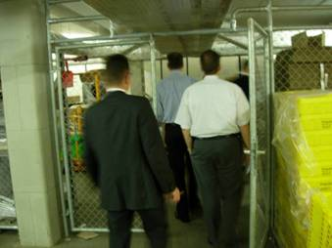
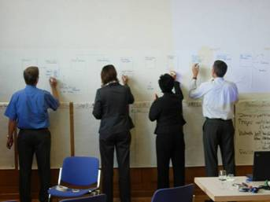
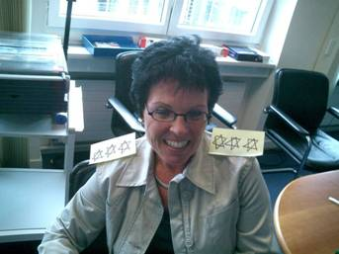
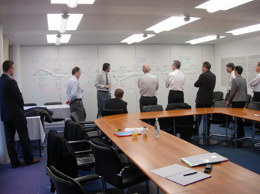
Why it works
teamwork
walking
creativity
communication

Slide 36
The Deloitte 5 Workshop approach in detail Our focus is on enabling people to demonstrate change and quick returns
M - Mobilisation Workshop
CS1 - As-Is High level Workshop
CS2 - As-Is Detail Workshop
FS1 - Future State Workshop
FS2 - Implementation Planning Workshop
WP - Running the
Work Pilot
Outputs
Project Kick-off
Finalised Scope
High-level process
Team Selected
High level plan agreed
Customer requirements
Plan interviews and current state mapping
Current State map
Report back to key stakeholders
Future State map
Report back to key stakeholders
Implementation plan & charters
Final Report back
Rapid execution of the quick hits and impro-vement opportunities identified
Confirm expected benefits
Initial identification of the “just do it” to be refined and designed, ready to be executed
Key Activities
Lean Awareness
Validation of end to end process scope
Value tree analysis
Refine charter
Confirm data requirements
Identify design boundaries
Lean education by “doing” in a practical environment - team building
Review charter, SIPOC and demand
Understand who the customers are (VOC) and their requirements
Value Stream Flow
Plan for ‘seeing is believing’
Seeing is Believing - Walk the process to understand what really happens, how long it takes, and what the key issues are
Construct the current end to end value stream map
Conduct value and waste analysis; identify what is preventing the value to flow
Define blue sky vision and agree future state lean design principles
Map the future state
Highlight benefits
Identify the implementation work packages and draft charters
Prioritise work packages
Define a high-level implementation plan
Agree pilot content
Agree governance and gain stakeholder buy-in
Test & refine the new streamlined process in a safe environment
Implement visual management
Develop standardised operating procedures
Measure new KPIs
Up-date the front line knowledge base,
Plan transfer to BAU
Tools and techniques
Problem scoping
Identify process owners, suppliers, customers (SIPOC)
Value Tree
Data collection
Project Charter
Lean simulation game
VOC data & CTQ
Understand demand - Mississippi Chart
Runners, Repeaters and Strangers
Value tree
Seeing is Believing
Value stream mapping
Baseline Metrics
7 wastes analysis
Root cause analysis and problem-solving
5S analysis (work place management)
Lean design principles
Pull systems and one piece flow
Mistake proofing
Andon system
Takt time
Cycle time diagram
Load balancing
Leveling heijunka
Improvement Work Packages charters
Ease versus Impact assessment
Gantt chart
Work pilot mission
5S environment
Standard Work
Decision Trees
Skill matrix
KPI & Run charts
Control charts
Quality matrix, FMEA
Problem solving & 8D
Notes:
Version

Slide 37

Roles and responsibilities of the team
Role | Role description | Responsibilities
 | Sponsor for the selected project The sponsor sets the project goal & objectives, provides input and agree the project charter He is accountable for the project success | Free up resources to support the project Promote the use of Lean as the preferred method for improving processes & ways of working Work with project manager to remove implementation roadblocks and facilitate change Attends “Report Out” sessions and progress reviews
 | Key business stakeholders who have an interest in the project success and/or who should be part of the implementation of the change (e.g. HR, IT…) | Responsible for providing resources and for supporting the implementation of the solutions Attend “Report Out” sessions and progress reviews
Project sponsor
https://www.youtube.com/watch?v=9Y8Lv6TM-lw
Stake-holders
https://www.youtube.com/watch?v=ZFAF8PXsA2g

Slide 38
Roles and responsibilities of the team
Role | Role description | Responsibilities
 | Team members are “doers” from the business and/or subject matter experts They have a deep knowledge of the process being improved | Responsible for supporting the Lean project manager in collecting data, mapping the process, generating possible solutions and implementing the solutions. Attends all workshops + 20% of time for 4-5 weeks + 1 day a week for implementation
 | Project Manager who is leading the Lean project from the mobilization phase through the implementation of the solutions | Responsible for applying the Lean approach, leading the assessment workshops and developing and implementing the solutions Coordinates all improvement efforts Attends all training and learn on the job
 | Lean Six Sigma expert whose role is to support the Lean project manager to run his project | Responsible for coaching & developing the skills of the Lean project manager by sharing his insights and providing practical guidance on the most appropriate Lean tools & technics
https://www.youtube.com/watch?v=LTKFaBvW6oc
Team members
https://www.youtube.com/watch?v=LWmIO0jCrIw
Lean project mgr
https://www.youtube.com/watch?v=0UYs5BkXKCg
Lean coach

Slide 39
Carrying out a Lean Project Standard planning and mobilized resources for a Lean project
 | Train | Prep. |  | Assessment |  |  |  | Implementation
 |  | Wk-2 | Wk-1 | Wk 1 | Wk 2 | Wk 3 | Wk 4 | Wk 5 | Wk 6 | Wk 7 | Wk 8 | Wk 9 | Wk10 | Wk11 | Wk12 | Wk13 | Wk14 | Wk15 | Wk16
Resources | Train | Prep. |  | Assessment |  |  |  | Implementation
Sponsor | n/a | 2hr meeting mobilisation |  | Sponsor attends the report out sessions (1hr30min) |  |  |  | Sponsor attends the fortnightly progress reviews (1hr) on the shop floor in the work pilot area
Stakeholders | n/a | 2hr meeting mobilisation |  | 4 to 6 stakeholders attend the report out sessions |  |  |  | 4 to 6 stakeholders attend fortnightly the progress reviews (1hr) on the shop floor in the work pilot area to understand the progress made and support the implementation
Team members | n/a | n/a |  | 5 to 8 people (1-3 days / wk) |  |  |  | 3 to 5 people 1 day minimum / wk to implement the to-be solutions and agreed future state + full time workers on the pilot (best to have the continuity of the people involved in the project)
Lean project manager | Full time | 1 day mobilise 1 day prep. |  | 1 day prep. / wk 1-3 workshop days / wk |  |  |  | 1 day / wk minimum to coordinate and to drive the implementation of the solutions + support of the manager(s) in charge of the process / area
Lean coach | Full time | 2 hrs coaching per wk |  | 2 hrs coaching / wk |  |  |  | 2 hrs coaching / wk 2 days training before the pilot kick off to cover Lean implementation of new ways of working (mindset and behaviours) and change management tools and techniques
Activities and deliverables
Project phases
Scoping and
Mobilisation
Lean process assessment
Implementation of the Improvement Work Packages
Scope
agreed
CS1
CS2
FS1
FS2
Pilot preparation
Work Pilot (Test cell)
Replication plan
Team
mobilised
Current state
mapped
Kick off
Pilot
Test Cell
Interim results
Test Cell
results
Transfer to BAU
Charter
signed off
Future state
mapped
Progress reporting and change management
Implementation plan established
Coaching
Report out sessions
T1
Coaching and support from Lean expert
T2
Coaching and support from Lean expert
Initial Lean training
Lean refresh
& Chg Mgt
KEY:
Deliverables
Weekly RAG report
Report out sessions / progress reviews
Coaching session

Slide 40
Agenda Day 1 - Introduction and Mobilisation
Section 1 | Introductions and Welcome Training Objectives
Section 2 | Background and History of Lean Six Sigma Deloitte Lean Six Sigma – The 5 Workshop Approach
Section 3 | Project Charter Problem Statement Scope (SIPOC)
Section 4 | Design Boundaries Project Governance (including Stakeholder Management)
Section 5 | Introducing the simulation Problem and Allocation of Roles Simulation Round 1
Business Case (Value Tree)
Record and Review Initial Statistics
Data Requirements

Slide 41
The Project Charter A statement of the scope, objectives and participants in a project
Creating the Project Charter is the first thing to do by involving the project sponsor
The Project Charter addresses a number of needs:
Provides a clear mission or purpose as to the reason for the project
Establishes the boundaries of the process to be investigated
Quantifies the current pain points or the opportunity
Translates an identified problem into terms that everyone can understand
Stipulates the success criterion and timeline
Aligns the team with the organization’s overall goals and, in doing so, ensures support
The Project Charter becomes a living document, a contract, as well as a roadmap by which the team will live by
The charter development process is an iterative and interactive process between the project sponsor, project manager and the key stakeholders.
Project Charter Steps
Opportunity Statement
Mission Importance and Business Case
Goal Statement
Project Scope and SIPOC
Project Sponsor
Team Selection
Project Plan
Project Start
Notes:
This is the charter template – may be a placeholder for the draft of the client project draft charter.
At this point, it is shown really to point out that the following activities will enable the charter to be updated – it’s intent is not to educate on the content of a charter.

Slide 42
Project Charter Establish a charter with a meaningful project title
Business Opportunities / Problem Statement |  |  | Goal & objectives
What is the problem ? | Describe the scale of the problem, where and when it is happening and which customer is impacted |  | Describe the overall project goal to achieve and the benefits to the business if the problem is resolved. SMART objectives need to be set
Where & When ?
Who is the Customer?
Estimated benefits to realise |  |  | Scope and risks
Estimated Benefits (Financial & Non-financial) | Impacts will be financial as well as non financial, particularly those that are customer or employee focused |  | In Scope | Out of Scope
 |  |  | Establish what will be in and out of scope of the project, specifying the project boundaries (start and end points)
Operational Measures to track future progress | Performance metrics with set targets are established to measure the project’s success
 |  |  | Potential risks
 |  |  | List the risks associated with the project scope
Time line of key milestones |  |  | Team and Stakeholders
Activities and deliverables |  | By Date | Improvement Team | Sponsors & Stakeholders
Mobilisation Current State 1 Current State 2 Future State 1 Future State 2 Work Pilot |  |  | Identify who are: Lean project manager Team members Lean coach | Identify who are: Sponsor Stakeholders
1
2
4
3
5
The plan:
8
6
7

Slide 43
Example of a simple Project Charter

Slide 44
Chanel’s Project Charter Example
Business Opportunities / Problem Statement |  |  | Goal & objectives
What is the problem ? | The overall year end process takes a long time to complete, from the closure of SAP FI to the sign-off of the audited consolidated financial statements. This project will focus specifically on the work performed by the French Accounting team responsible for the completion and submission of the Conso package4 package completed at D+30 |  | The overall objective is to accelerate all actual closing cycles with an initial focus on the year end process. The goal is to shorten the closing time by improving the core year end processes, while keeping the same level of high quality and without asking people to work harder or having additional resources to perform the work. The key objectives are to: Improve the end to end leadtime to submit the Conso package4 schedule by 10 working days Strengthen the quality of data from the local level and improve internal control system Drive speed and efficiency into the FIP implementation plan by submitting new improvements recommendations (e.g. requirements for automation)
Where & When ? | During the year end closure, but during the quarterly closure for the relevant packages or schedules that are completed
Who is the Customer? | head office is the recipient of the Conso package4
Estimated benefits to realise |  |  | Scope and risks
Estimated Benefits (Financial & Non-financial) | Reduction of the end to end leadtime by 10 days to submit Conso package4 Reduction of the number of journals posted after SAP FI is closed (both planned and un-planned JV) Improved standardisation of ways of working across the team Better control of the flow of information required to complete the Conso package packages |  | In Scope | Out of Scope
 |  |  | Start: D+0 End: D+30 submission of Conso package4 French perimeter (24 entities) French Accounting team Conso package4 (B/S, 26 Supplementary Schedules) Journals posted from D+0 | Intercompany reconciliation (to be reviewed after the 24/07 presentation) Work performed by the Controllers (Conso package1 and Conso package2); SDP and STP Europe perimeter Q&A with head office Consolidation
Operational Measures to track future progress | End to end time to submit the Conso package4 package Number of planned journals after SAP FI close Number of exceptional journals (non planned) after SAP FI close Number of corrections following internal reviews and head office Q&A
 |  |  | Potential risks
 |  |  | Availability of resources – this risk has been mitigated by scheduling a series of one to one meetings with each team member
Time line of key milestones |  |  | Team and Stakeholders
Activities and deliverables |  | By Date | Improvement Team | Sponsors & Stakeholders
Mobilisation meeting with Sponsor and stakeholders |  | 28/06/12 | Team leader: Katja Balon Lean Facilitator: Xavier Muller Team members Angélique Gonon Carine Béhal Christelle Auger Eva Partouche Pedouth Bouaziz Sylvie Mortier Valérie Devineau Xavier Pagenel | Sponsor Anne Aubert Stakeholders Luc Dony Dennis Gannon
Introduction to Lean Management |  | 03/07/12
One to one meetings with each team member to map as-is process |  | 13/07/12
Review of the exceptional journals posted after D+5 |  | 16/07/12
Review of the current state assessment |  | 17/07/12
Definition and design of the future state |  | 18/07/12
Establish the high level implementation plan and recommendations |  | 19/07/12
Presentation of the findings and recommendations |  | 24/07/12

Slide 45
Focusing on the problem statement Making sure everyone understands and agrees what the problem is clearly
A problem statement:
Contains information that gives specificity to the issue
Describes the pain caused by the current problem
Identifies the issues
What is occurring / happening?
Example: Products are delivered late to our customers
When did the problem start?
Example: The problem has developed over the last four months
Where is the occurrence?
Example: Our Hong Kong customers were mainly affected
(approximately 70% of the total)
Who did the problem effect?
Example: Only employees using the ‘delta’ workflow management application
How many? What is the extent of the problem?
Example: 64 orders worth $820,000 in March

Slide 46
Validate the problem statement and the scope with the team
Objective: Making sure everyone understands and agrees on what is the real problem to be solved
Team work: Review the project charter focusing on the problem statement and the project objectives
IN SCOPE |  | IN OR OUT? |  | OUT OF SCOPE
Who are the customers / segments / channels What products are considered? What components of the business are included? What areas? locations? What are the starting and ending points of the process? What are the outputs of the process under review? What systems are used? |  | To be validated with Sponsor, team members or specific Stakeholders |  | What, if anything, is outside of the project boundaries? What components of the business are not included? Functions? What areas? locations? What products / services? Which suppliers ? Which systems ?
?
?

Slide 47

So What’s the Problem?
5 minutes
Smith’s Problem Handout
Brown, the drill press operator in Department A was working at his job, drilling the #1 hole in angle plates.
He had cut his finger while moving tote pans of material to the work area.
The standard specifications for the job called for gauging one piece in twenty for size. Brown did this and although the pain from his finger was diverting his attention all that he gauged seemed to be good. He therefore had no indication that the drill was dull nor that the machine wasn’t running at the correct speed. It was just as the set-up man had left it. By mid-morning he had completed five tote pans for a total of 100 pieces.
Smith the Supervisor suddenly called Brown to his desk and reprimanded him for carelessness in his work.
Brown was angry and felt discouraged. He told the supervisor he was going home at noon.
Smith the Supervisor was worried because Department B needed the work now or they would stop production. The Inspector had told him that a great many of the angle plates were off specifications
Notes:
Ask each individual team to write a problem statement for this issue. Time = 5 minutes.
The key question to ask the attendees is what is the problem? They can only give one answer. They should work as individuals and come up with the problem that needs solving. Once everyone has had 5mins to think about it then collect the various problems and put headings onto a flip chart. The facilitator will find things such as Health & Safety, Quailty, Management, Training etc that will be brought up; make a tally of the repeated ones. At this point you can look at the list and see that even for a simple problem there can be many views on the problem to be fixed. They are driven by our own experiences and knowledge and can be very biased. As LSS consultants we need to be able to be impartial and see beyond the given problem to make sure what we look at is able to identify the true problem. You can, if you want, introduce a voting section here but often people are still not agreed with the outcome. This then highlights the key to have a single voice to agree the final scope and problem; avoid multiple sponsors. The ideal problem statement here is around supply to Plant B and how to ensure a consistent supply and quality from plant A and that also includes feedback of quality from plant B.

Slide 48
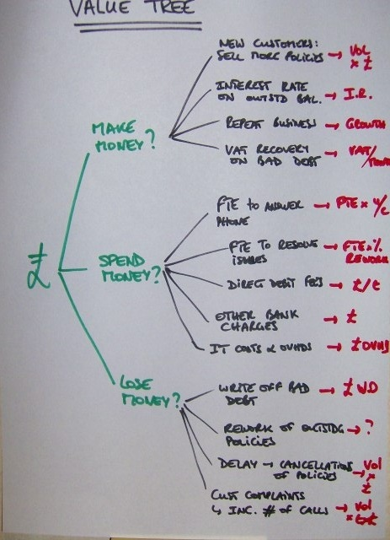

Business Case Using the value tree to identify the business case
Objective: Identify the potential benefits
Key questions:
Where in this end-to-end process are we making money?
Where are we spending money?
Where are we losing money?
Team work:
For each branch of the tree, we identify:
What & where are the cost/revenue drivers in the process?
How do we measure them?
Hot Tips
Capturing the baseline with the value tree will help you to understand the data requirements and to build the future state business case
Notes:
Considering the value tree at this stage will assist in quantification of the benefits and inform us on which data we need to clarify the situation early in the project
Use a Deloitte value tree for the industry as a prompt if required

Slide 49
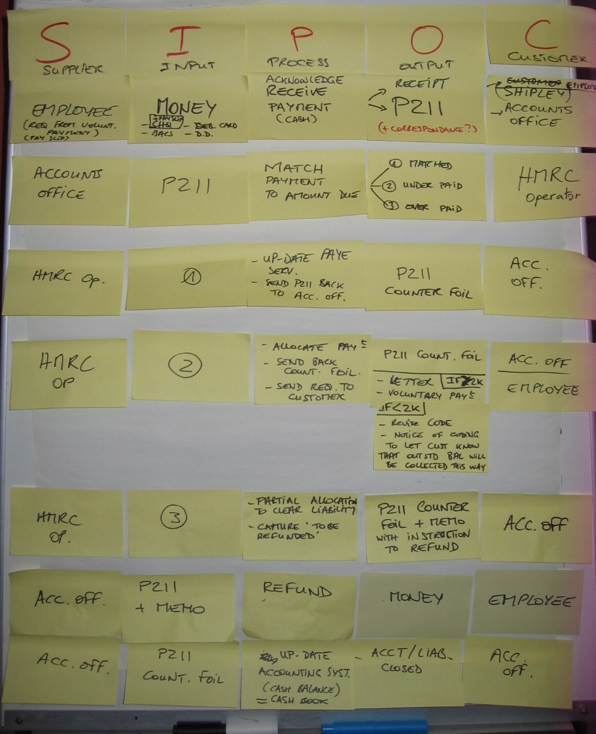
Scope Using a SIPOC to help define your scope (start and finish)
Objective: Identify the 5 or 6 high level process steps within scope
Key questions:
Where does the process start? Where does it end?
Who is/are the customer(s) & suppliers?
What are the main process steps
What are the inputs and outputs
Team work:
Confirm the scope of the value stream
Identify the Supplier, Inputs, Process, Outputs and Customers of the process
Hot Tips
SIPOC gives you a clue about the complexity of the process and helps you identify the business areas where the team members and stakeholders should come from
Notes:
By constructing the SIPOC at this stage it will help to identify stakeholders and team as well are clarifying the scope that has been defined

Slide 50
Chanel’s SIPOC Example
End to end process to submit Conso package
Purpose | Submit year end financial data to head office
Process owner | Katja Ballon
Start | D+0: First day of the year end closure cycle
End | D+30: Conso package submitted in HFM
Suppliers
Inputs
Process
Outputs
Customers
GL Accounting team
AR Accounting team
AP Accounting team
Fixed Assets team
Controllers
Commercial Agents
Legal team
Treasury team
Third parties (External accountants)
GL extracts from SAP
Evidence files and emails sent by suppliers
Empty Conso package files
Standard Excel templates
Non standard Excel files
Process to complete, review and submit all financial data entries owned by the French Accounting team to head office through HFM
SAP FI closed
Package completed, reviewed and uploaded into HFM
Closure files made of the printed copy of the Conso package with evidences:
“Rapprochement de situation nette” files
Evidence files
Journals
head office
D+0 - Prepare data
D+13 - Input data
D+16 - Control data
D+30 - Submit data
Request data
Receive and check data
Input data in Conso package
Review Conso package
Upload HFM
Prepare and post data in SAP
Read or extract data from SAP
Systems
Data | Net Income (Tab 1) + Balance Sheet (Tab 2) Intercompany schedules (Tab 4.x) – to be reviewed later All supplement schedules
ABC
SAP
Excel
HFM

Slide 51

Exercise 1 All Pizzas Great & Small
You have a friend who is manager of the local take-away/home delivery pizza shop “All Pizzas Great & Small”.
He has started to suffer from a recent decline in business.
Staff turnover has been high and recently customer complaints have increased.
Customers are getting increasingly frustrated about late delivery of their telephone orders.
Not only are they late but pizzas are arriving lukewarm and are unappetising.
Scenario
This is being reflected in weekly turnover which seems to be in decline, this is now starting to get him very worried about costs and the future of the business.
Problem
You have recently been on Lean Six Sigma Training . You offer to help your friend turn the business around in return for an annual supply of free pizza!
Role

Slide 52
Exercise 1 Your Task
In your Groups, please decide on the following, in order to help your friend in his pizza shop and receive that annual supply of free pizza!
Project Charter
SIPOC
Value Tree
At the end of each stage please be prepared to share your ideas with the rest of the group.
20 minutes
20 minutes
20 minutes

Slide 53
Exercise 1a Project Charter (Example Answer)
Business Opportunities / Problem Statement |  | Goal & objectives
Over the last 3 months there has been a growing number of customer complaints mainly from home delivery customers from about 5 per week to over 30 per week. Weekly revenue is also showing a decline. Over 80% of the complaints are due to a combination of late delivery and cold unappetising Pizza when delivered |  | To reduce customer complaints on home delivery orders from 30 back down to the baseline level of about 5 Per week within 3 months
Estimated benefits to realise |  | Scope and risks
Weekly revenue on Home delivered Pizzas has fallen by over £500 per week during the last 3 months. Customers are known to be switching to Dominos on the other side of town and we are losing share. Home deliveries represent > 60% of our business. If this problem is not resolved quickly our financial plans suggest we will soon have to close down. |  | In Scope | Out of Scope
 |  | Home delivery Pizza orders | Take away Pizza sales Non Pizza sales
 |  | Potential risks
 |  | High staff turnover makes sustainable improvement tricky
Time line of key milestones |  | Team and Stakeholders
Activities and deliverables | By Date | Improvement Team | Sponsors & Stakeholders
Mobilisation Current State 1 Current State 2 Future State 1 Future State 2 Work Pilot |  | Identify who are: Lean project manager Team members Lean coach | Identify who are: Sponsor Stakeholders
Notes:
Suggest trainer/facilitator leads discussion with group about whether/how this charter could be improved

Slide 54
Exercise 1b SIPOC ( Example Answer)
Suppliers | Inputs | PROCESS | Outputs | Customers
 | Use nouns | Use verbs | Use nouns
Customer | Request for Pizza | Take Order | Written Order Agreed Price & delivery time | Pizza Cook Customer
Shop Manager Food suppliers ( Merrichef, Macro) Shop Staff | Written order Recipe Prepared Ingredients | Select Ingredients | Correct amount of each ingredient | Pizza Cook
Shop Manager | Topping Ingredients Cheese Dough Base Work instructions | Make Pizza | Prepared Pizza
Shop Manager Tray Supplier (Alcan) | Prepared Pizza Oven at right temp Cooking tray | Cook Pizza | Cooked Pizza | Delivery driver
Packing supplier Delivery driver Order taker | Pizza Boxes Motorcycle with Fuel Bill Delivery Address | Pack & Dispatch | Delivered Pizza | Customer

Slide 55
Exercise 1c Value Tree ( Example Answer)
Existing customers
Sell more Pizza
Recover lost customers
Make Money
New customers
Up-Sell more Drinks and add - ons
Spend Money
Ingredients
Packaging
Wages
Fuel
Lose Money
Wasted Ingredients
Returned Pizzas
Discount/Credit for complaints
Notes:
Trainer/Facilitator lead discussion on what the best drivers & measurements would be for each arm of the tree

Slide 56
Agenda Day 1 - Introduction and Mobilisation
Section 1 | Introductions and Welcome Training Objectives
Section 2 | Background and History of Lean Six Sigma Deloitte Lean Six Sigma – The 5 Workshop Approach
Section 3 | Project Charter Problem Statement Scope (SIPOC)
Section 4 | Design Boundaries Project Governance (including Stakeholder Management)
Section 5 | Introducing the simulation Problem and Allocation of Roles Simulation Round 1
Business Case (Value Tree)
Record and Review Initial Statistics
Data Requirements

Slide 57
Design Boundaries There may well be various business blockers and constraints within which you must work
With any improvement programme there will be business environment factors which will influence the scope and constrain its implementation
In the mobilisation phase we need to work with key stakeholders to define and understand these
Assess the environmental conditions and the key project constraints:
Understand anything that may constrained the improvements or impede the flow of the work and is not directly related to the operational work
Are there any other projects impacting the scope?
To which degree systems may be changed or up-graded in the to-be design?
What are the limitations that cannot be changed?
Can we challenge them?
IT
Location
Organisation
Typical Design Boundaries
Compliance
Legal
Other
Programmes
Risk
Notes:
This slide should be used to prompt the group to identify the boundaries they associate with the project
These should be noted on a flip chart

Slide 58

Design Boundaries There may well be various business blockers and constraints within which you must work
Key questions:
Are there any other projects or initiatives impacting the scope?
What are limitations that cannot be changed?
Can we challenge them?
Team work:
Brainstorm the boundaries or controllable environmental factors impacting the scope
For each topic, identify the key constraints and challenge their impact on the project
Hot Tips
These design boundaries will be used to define a realistic future state of the improved process. It is therefore important to understand what you can/cannot do
Notes:
This slide should be used to prompt the group to identify the boundaries they associate with the project
These should be noted on a flip chart

Slide 59

Project governance arrangements A vital part of the project
Objective: Set a simple & effective project governance
Key questions:
How are we going to measure and report progress?
Who needs to know about it? And how often?
Team work:
Confirm who your stakeholders are using a RACI
Confirm the report out dates
Agree on a simple report to show progress and escalate issues
Hot Tips
Agreeing governance arrangements with the Sponsor is key to ensure full support and commitment of the team and stakeholders
A weekly progress report should cover :
Progress to date
Next week activities
Top 3 risks and 3 issues
Notes:
Use this to ensure that
You have confirmed who all the stakeholders are – more than 6-8 is probably too many unless the circumstances are particular
Confirm the report-out dates – ensure the sponsor and stakeholders in attendance know that they are required to attend and that they may need to inform other stakeholders to attend – this is where decisions will be made
Suggest a weekly reporting timetable and make sure everyone is happy with this

Slide 60
Typical Mobilisation Workshop Agenda An Overview
Outputs
Project Kick-off
Finalised Scope
High-level process
Team Selected
High level plan agreed
Key Activities
Lean Awareness
Validation of end to end process scope
Value tree analysis
Refine charter
Initial identification of data requirements
Identify design boundaries
Tools and techniques
Problem scoping
Identify process owners, suppliers, customers (SIPOC)
Value Tree
Data collection
Project Charter
Attendees
Sponsor
Project Lead
Lean Coach
Stakeholders (optional)
2hrs meeting

Slide 61
Typical Mobilisation Workshop Agenda
Hot Tips
Give the Sponsor & stakeholders an overview of the Lean approach
Create / refine the project charter by
Agreeing the scope and objectives of the project
Understanding the high level process using the SIPOC in order to select the right team (one representative from every dpt impacted)
Clarifying the business case
Refining the problem statement to gain agreement on what the real problem is
Workshop planning
Secure the resources and agree their time commitment for the whole duration of the projects (the most important phase is the implementation)
Identify of the types of data required to support documentation of the as-is process to start gathering and collecting data as soon as possible
Agree the on-going governance and progress report

Slide 62
Agenda Day 1 - Introduction and Mobilisation
Section 1 | Introductions and Welcome Training Objectives
Section 2 | Background and History of Lean Six Sigma Deloitte Lean Six Sigma – The 5 Workshop Approach
Section 3 | Project Charter Problem Statement Scope (SIPOC)
Section 4 | Design Boundaries Project Governance (including Stakeholder Management)
Section 5 | Introducing the simulation Problem and Allocation of Roles Simulation Round 1
Business Case (Value Tree)
Record and Review Initial Statistics
Data Requirements

Slide 63

Introducing the Simulation Lets try and implement the approach
Situation
Acclaim Inc (AI) is based in two locations, and is inundated with work requests to repair houses. Due to new legislative requirements, they are not allowed to conduct the survey on the building (as they will be completing the work once the survey is complete), and so contract the services of Service Corp (SC).
During this simulation, it is Service Corp’s responsibility to quote a price for all the work requests Acclaim Inc send to them.
Most participants will be employees of Service Corp, and some will work for Acclaim Inc. Service Corp wants to convince Acclaim Inc that they are meeting their performance expectations!
Ground Rules
No changes will be allowed in Round 1. You will be able to make changes for later rounds
The purpose is to establish a baseline before improvement
Don’t look for any tricks as there are none

Slide 64
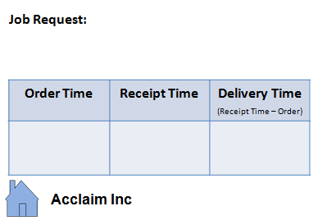
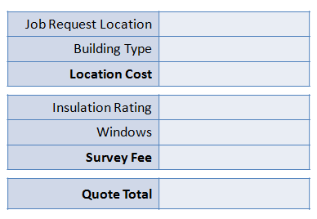
Introducing the Simulation The important information
Job Request Cards

Slide 65
Simulation Round 1 Allocation of Roles
Pick Role
Please draw card from the envelope
Learn Role
Find your seat an learn the role
Questions
Ask the facilitator or your manager if you have questions
Get ready
Please prepare your station to play Round 1
10 minutes

Slide 66


Simulation Round 1 Start
Run Round 1 for 12 minutes

Slide 67

Simulation Round 1 Feedback and post round summary
Feedback - How did it go?
End to End (E2E) process
WIP levels
Idle time
Morale during the process

Slide 68
Data and Information Requirements Collecting Data to understand the current state of the process
Discuss back in your groups...
What type of data have you collected?
What else might be of use to understand the process?
What are the following and how might they be of use?
Discrete and non-discrete data
Performance reports
Customer complaints / satisfaction scores
Sales figures
Customer demand (historical/forecast)
Lead time
Process touch time
Backlog volumes
Defect and accuracy rates
Rework rates
Bottlenecks
FTEs
Organization charts
Data collection plan
10 minutes
Notes:
This is a typical list that can be used to prompt a discussion on what data is required to support the project

Slide 69
Day 1 review and wrap up What we have covered today
Introduction
Training Objectives
5 Workshop Approach
Background & History of Lean Six Sigma
Project Charter
Design Boundaries
Project Governance
Data (ref Simulation)
✓
M
CS1
CS2
FS1
FS2
W
Notes:
This is to allow the facilitator to sum up what has been covered in the workshop and what the key actions coming out of it are.
All actions should be captured in a single list which defines the action, who is responsible for completing and when it should be completed by

Slide 70
Looking ahead to Day 2 Day 2 - Current State 1, Current State 2
Section 1 | Quiz from Day 1 Introduction to Current State
Section 2 | Voice of Customer (VOC) Critical to Quality (CTQ)
Section 3 | Identify Quick Wins Simulation Round 2
Section 4 | Seeing is Believing Value Stream Mapping Identifying Waste
Section 5 | Exercise - Value Stream Mapping Exercise - Value Add Analysis (using TIM WOODS)
Section 6 | Dummy Workshop Agenda Day 2 Review & Wrap up

Slide 71

Reflexion time In your own time, consider to…
Reflect on how best to prepare for your own project?
Could you prepare a draft Project charter?
Is the problem statement relating to what the customer experience?
Are the project objectives SMART?
Can you prepare a SIPOC for your project to ensure that all key stakeholders and team members have been identified?
Reflect on what tools/technics you could apply in your day job?
What tools or technics could you apply to your day to day activity?
What can you do to define better the issues you are dealing with?
In order to assess your understanding of this course, these deliverables will be reviewed on the last day of the training

Slide 72

WWW & WBBI Your thoughts
What Worked Well?
Would Be Better If...?

Slide 73


